Slide 1
Exploring the bottom-up approaches for international governance of space
Tomas Hrozensky
chairman – Slovak Space Policy Association NGO, PhD. student – Matej Bel University, Banská Bystrica, Slovakia
ECSL Young Lawyers’ Symposium 2017

Slide 2
Idea and motivation
rising imbalance between development in space technology and progress in legal and regulatory arena for space
success of some bottom-up approaches vs. hibernation and stalemate of top-down designed

Slide 3
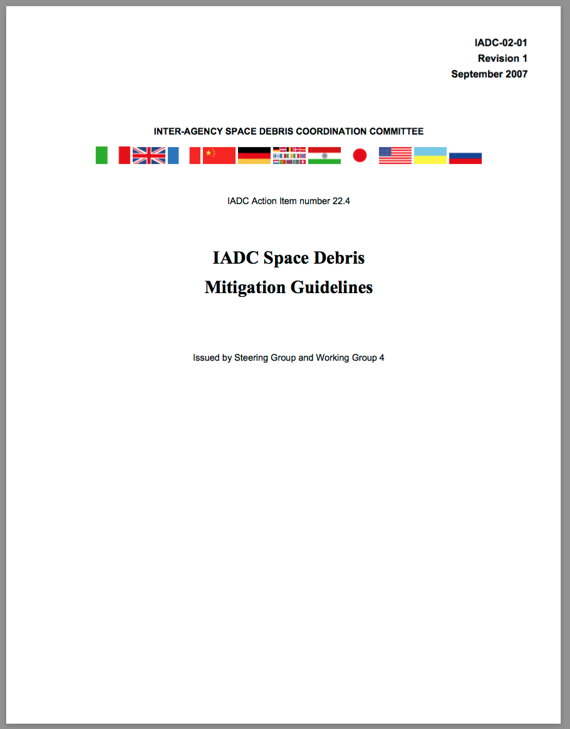
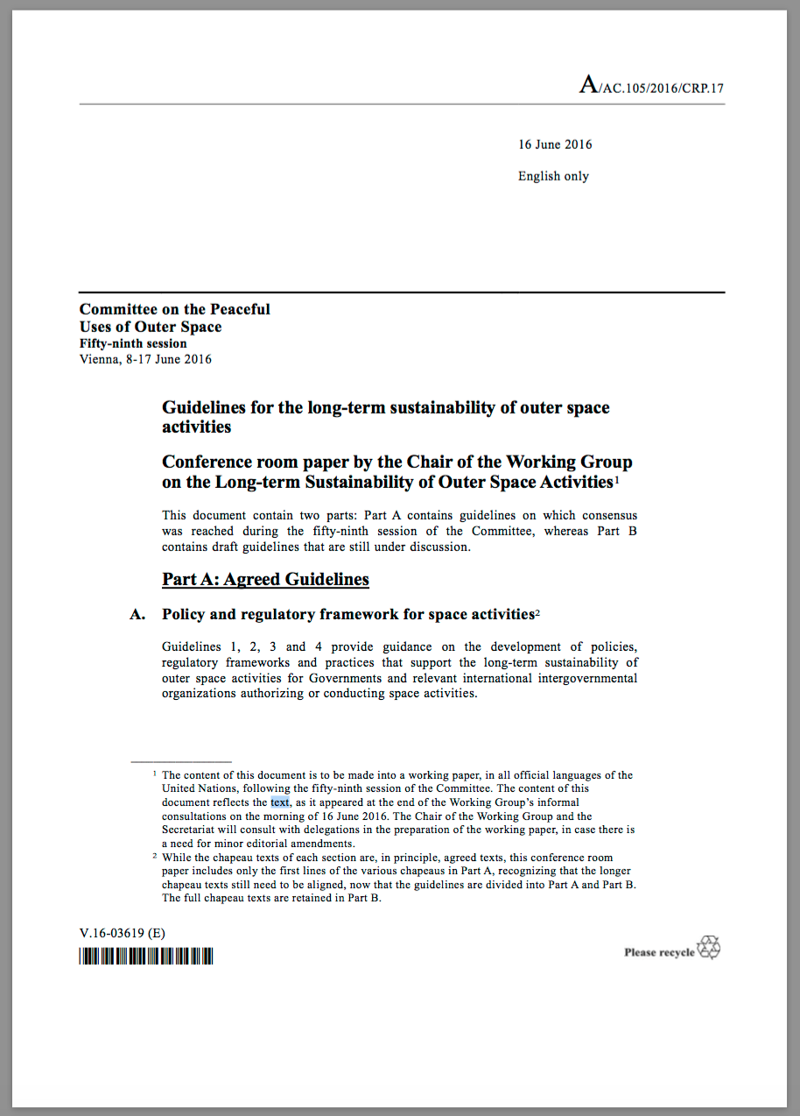

Slide 4
Rationale and background
risky efforts in opening current legal framework
positive assessment of bottom-up initiatives in literature
recent experience with bottom-up approaches
rationalist tradition applied to both state and non-state actors

Slide 5
How?
building upon proven efforts but also going deeper
deeper = more directly to the industry
role for nat. administrations and int. bodies – fostering the industry incentives, creating favorable conditions for implementing bottom-up initiatives

Slide 6
Suggestions
more platforms for representatives of commercial / private space at int. forums for space
adjustments in the COPUOS agenda and agendas of its subcommittees
fostering the creation of more space industry associations and space industry best practices

Slide 7
Challenges and questions
bridging the gap between political / diplomatic nature of space governance forums and business / finance nature of private space sector
interests of commercial and private sector
bypassing the existing regime, creation of duplicate parallel mechanisms

Slide 8
Talking points
What are the possibilities to include representatives from / of private space sector more often at the global space governance platforms?
How to refurbish the COPUOS agenda items so that agendas of COPUOS and its subcommittees would reflect contemporary trends and developments more adequately ?
Would it be viable to foster more and detailed space industry best practices as a precursor for discussions about new or updated mechanisms for international space governance?

